Slide 1
Announcement:
Midterm 1 this Friday (calculator allowed, one cheat sheet allowed)
Come to class 10 minutes earlier
Graduate students sit in odd columns, undergraduate sit in even columns

Slide 3
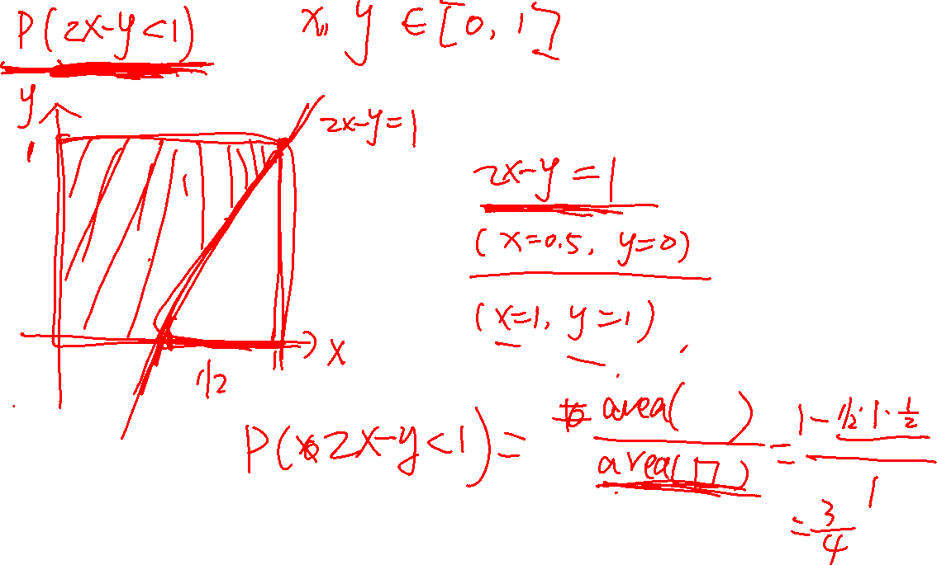
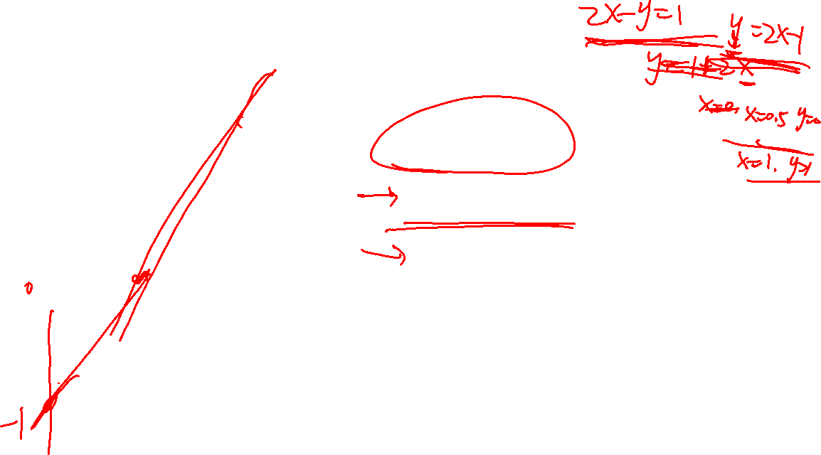

Slide 4
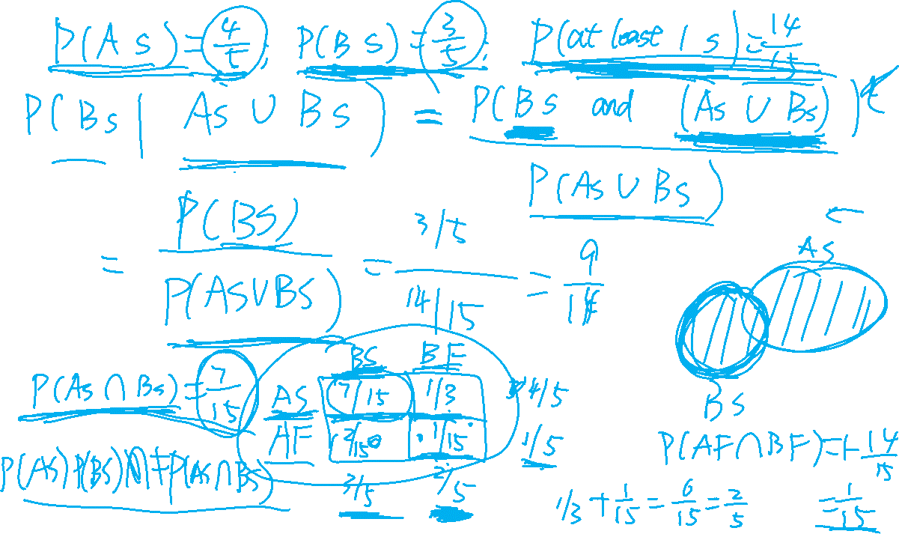

Slide 5
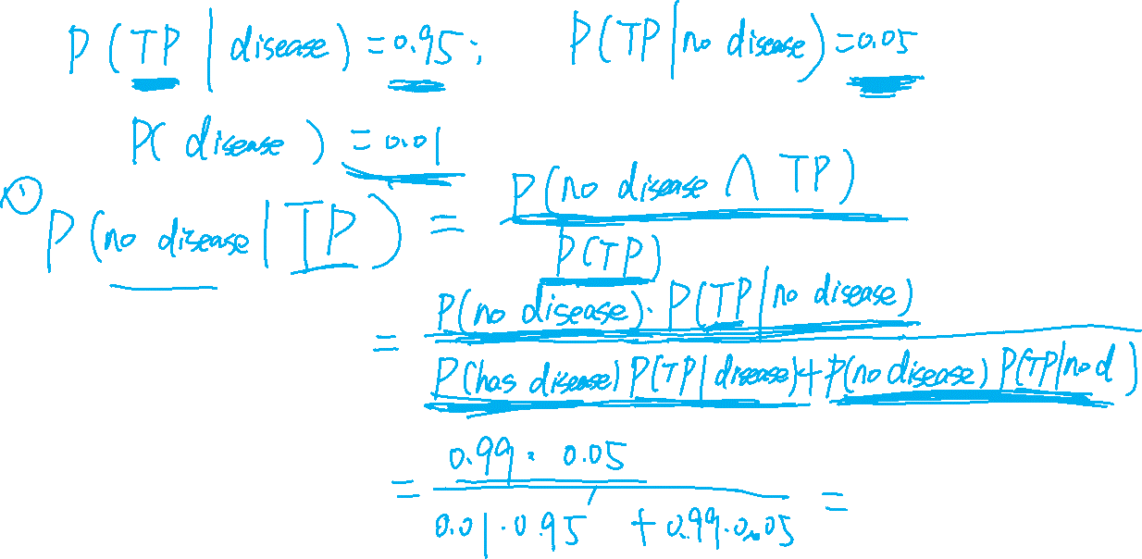
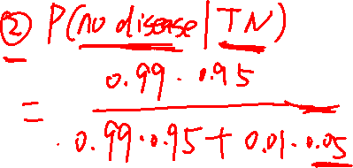

Slide 6
